Slide 1
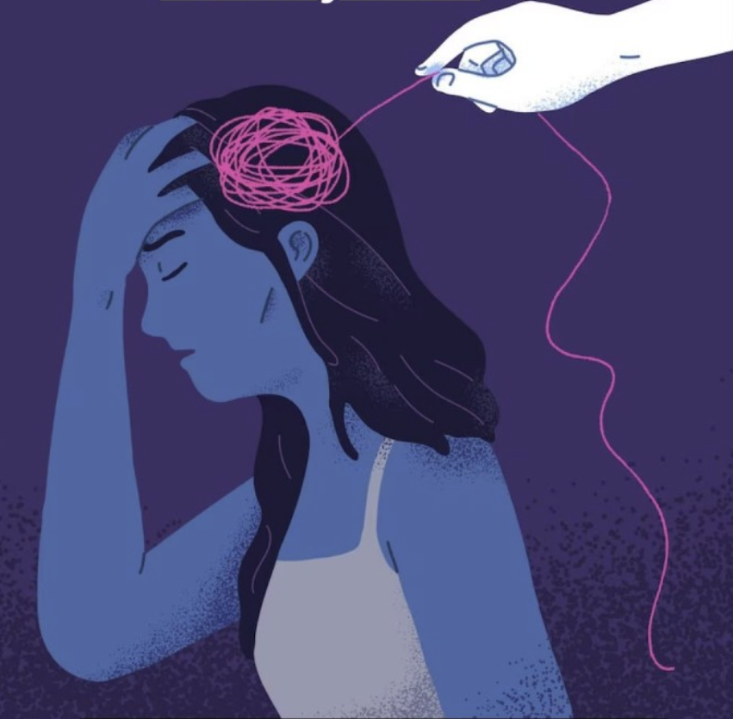
Psychological Abuse in Romantic Relationships
Tejus – 102115103
Achintya – 102115126
Akshit - 102115127

Slide 2
TABLE OF CONTENTS
01
02
03
04
05
INTRODUCTION
AIM OF THE RESEARCH
LITERATURE OVERVIEW
OBJECTIVES
RESEARCH METHODOLOGY
06 KEY FINDINGS

Slide 3
Introduction

Slide 4
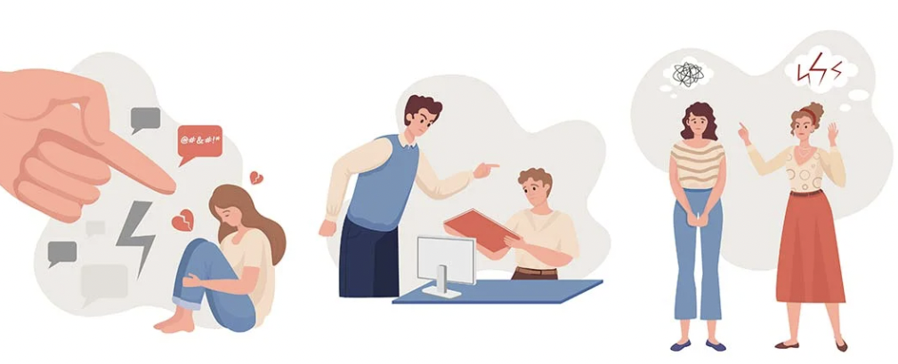
Psychological Abuse
Psychological abuse can be defined as regular and deliberate use of a range of words and non-physical actions to manipulate, hurt, weaken, or frighten a person mentally and emotionally and distort, confuse, or influence a person’s thoughts and actions within their everyday lives, changing their sense of self and harming their wellbeing. It includes verbal assault, dominance, control, isolation, ridicule, or the use of intimate knowledge for degradation (Follingstad, Coyne, & Gambone, 2005). This is done to targets the emotional and psychological wellbeing of the victim, and can be a precursor to physical abuse.

Slide 5
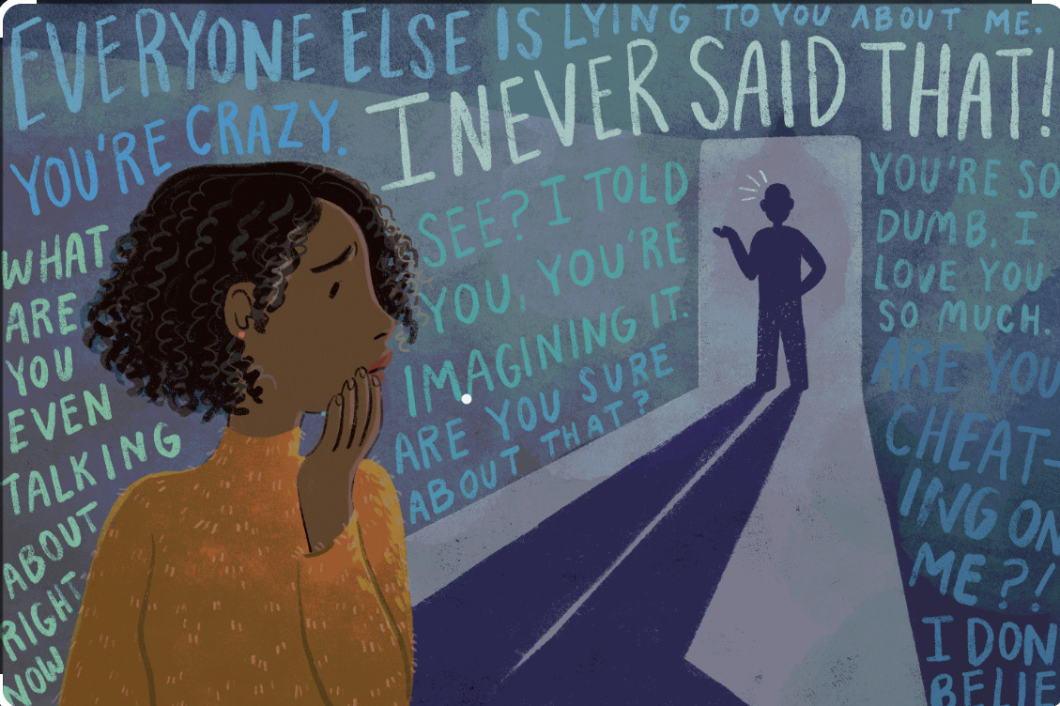
Gaslighting
Gaslighting is a form of emotional abuse where the abuser tries to manipulate the victim into doubting their own memory, perception, or sanity. This is usually done by denying or distorting the events that actually took place and making the victim feel like they are the one who is crazy.

Slide 6
Silent Treatment
Silent treatment is a tactic that involves purposefully refusing to communicate with someone who is willing to communicate. This form of social ostracization, also known as giving someone the cold shoulder, can be a damaging choice of response. It leaves important issues unresolved and can make the receiving partner feel hurt, confused, frustrated, angry, unimportant, and unloved.
If someone is upset that their partner comes home late most nights, they initiate a conversation to express their feelings and try to understand why their partner is habitually late. However, suppose the partner does not want to take responsibility for the upset they've caused or refuses to acknowledge or change their behavior. In that case, they might respond by saying, "I'm not talking about this," or they might choose to say nothing at all and ignore the issue altogether.
This refusal to talk is different than asking to postpone the conversation and pick it up later, which indicates the issue will be discussed at a more convenient time for both partners and can be a healthy choice.
Research has shown that when we perceive a threat to our social bonds, it triggers our sympathetic nervous system and lights up the dorsal anterior cingulate cortex - the region responsible for processing pain. In short, rejection or being ignored can be emotionally painful.

Slide 7
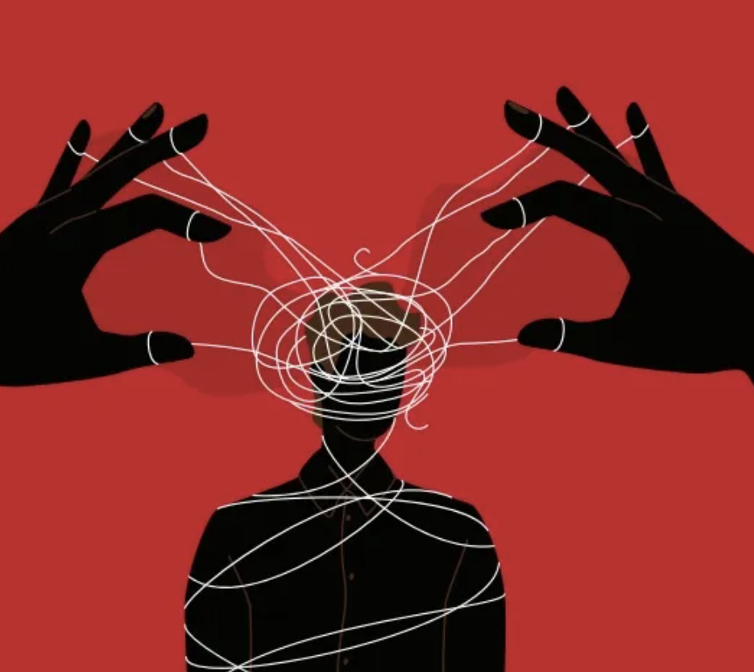
Aim of the Research
The aim of the research was to assess people’s attitudes about concepts related to psychological abuse.

Slide 8
Literature
Review

Slide 9
Silent treatment can generally be understood to cause psychological distress to the individual receiving it. Evidence of this can be found in a study by Williams, Shore, and Grahe (1998).
There could be several motives or intentions of individuals withdrawing from confrontation and giving silent treatment. As has been found in a study by Zadro, Arriaga & Williams (2008) these motives are intended to hurt the person receiving silent treatment.
In a study over 80 couples with a mean age of 24, it was found that a person is more likely to “give in” to their partners’ strong emotional reaction, or let the partner do something which s/he would not have otherwise been able to do if they didn’t show a strong emotional reaction, as the person is now highly attached to their participant and s/he cannot bear to see their partner “sad”, or sometimes just for the sake of “maintaining the relationship” the partner gives in to their partners’ strong emotional reactions. (Carnelley et al., 2006)

Slide 10
Various studies have found that in a relationship having an unequal power dynamic, the male partners had more power for making decisions than the female partners (Peplau, 1979; Femlee, 1994). Research on power in the household seeks to explain power in terms of “cultural ideologies of gender, particularly those of breadwinning, which construct the man as the main earner” (Zelizer, 1989). (Edgell, 1980) took this further by showing that not all financial decisions were equally important.
In a study conducted by Saxey et al. (2022), it was found that emerging adults may financially deceive their romantic partners. This study was conducted on 1950 emerging adults in the US, results indicated that couple financial communication, the similarity of financial values, and financial socialization may contribute positively toward romantic relationship flourishing but financial socialization and financial deception may contribute negatively toward romantic relationship flourishing.

Slide 11
Objectives

Slide 12
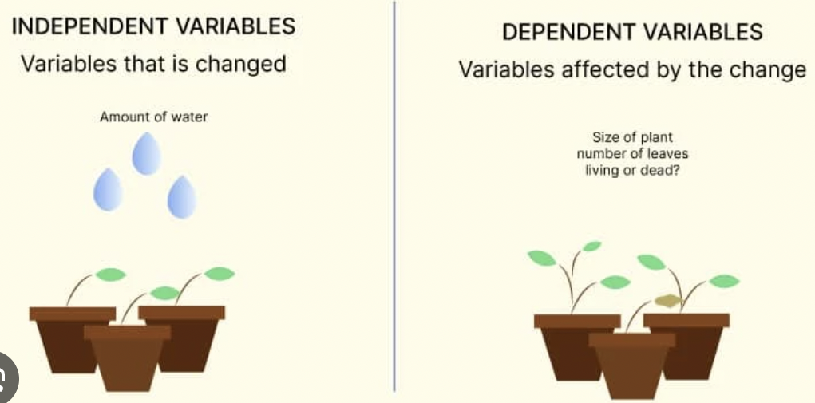
Independent Variable and Dependent Variable
In an experiment, researchers aim to understand how changes in one variable affect another variable. The variable that is changed or controlled by the researcher is known as the independent variable, while the variable that changes in response to the manipulation of the independent variable is known as the dependent variable. By manipulating independent variables and measuring the effect on dependent variables, researchers can draw conclusions about the cause-and-effect relationship between the two variables.

Slide 13
Research Methodology

Slide 14
To adequately gauge and understand the impact of psychological abuse in relationships, a google form was floated.
The form contained several questions and the aim was to gather a general sense of what people consider appropriate in their relationships.

Slide 15
The following slides contain our research questions

Slide 16
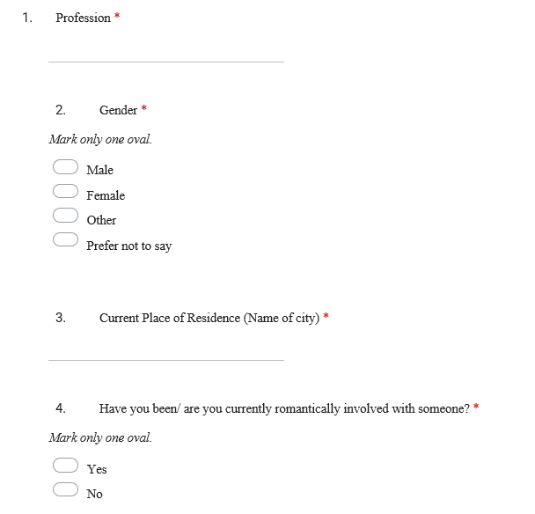

Slide 17
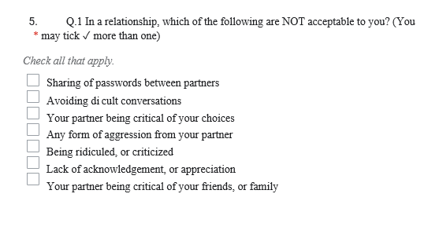

Slide 18
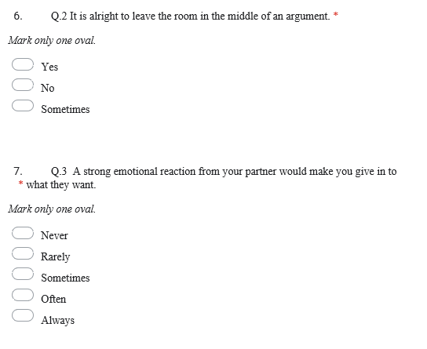

Slide 19
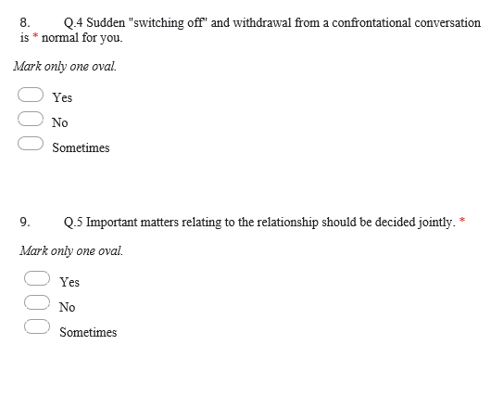

Slide 20
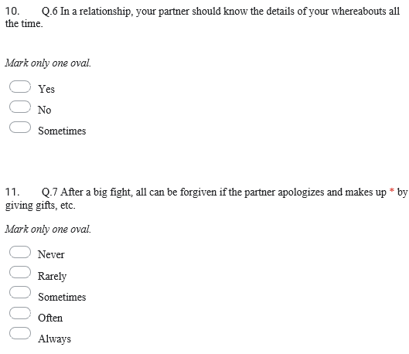

Slide 21
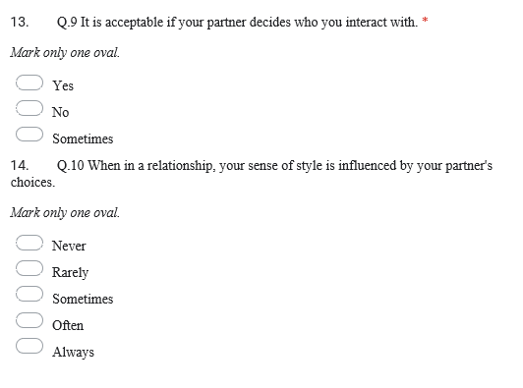

Slide 22
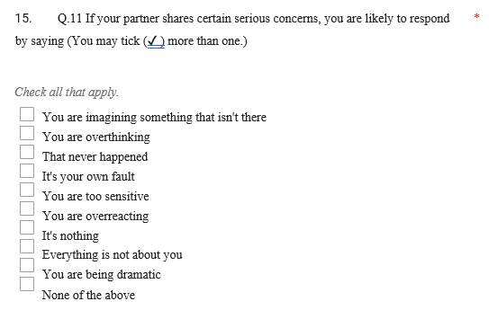

Slide 23
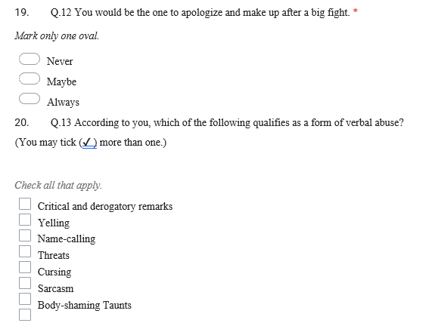

Slide 24

KEY FINDINGS

Slide 25
(1) People have long-lasting effects on mental health. They are more likely to experience depression, anxiety, post-traumatic stress disorder (PTSD), and other mental health issues.
(2) People isolate themselves from their friends, family, and support networks, making it harder for them to seek help or leave the relationship. This isolation can exacerbate the their feelings of helplessness and dependence on the abuser.

Slide 26
THANKYOU

